Slide 1
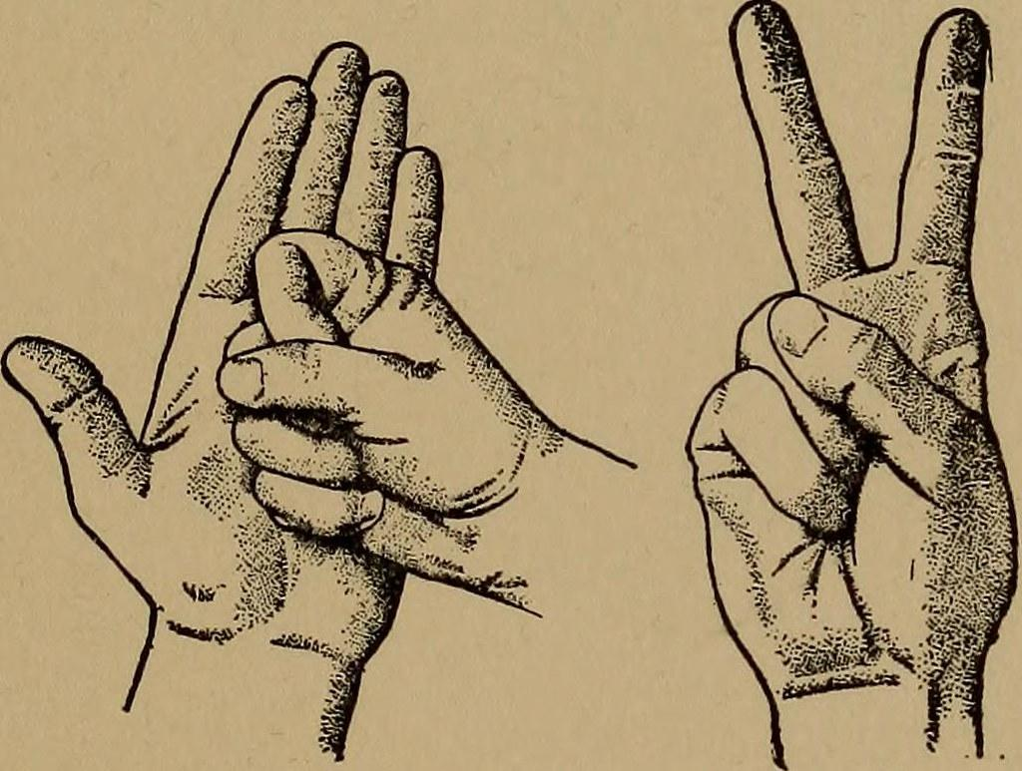
DETECTION OF HAND GESTURES AS STONE PAPER AND SCISSOR

Slide 2

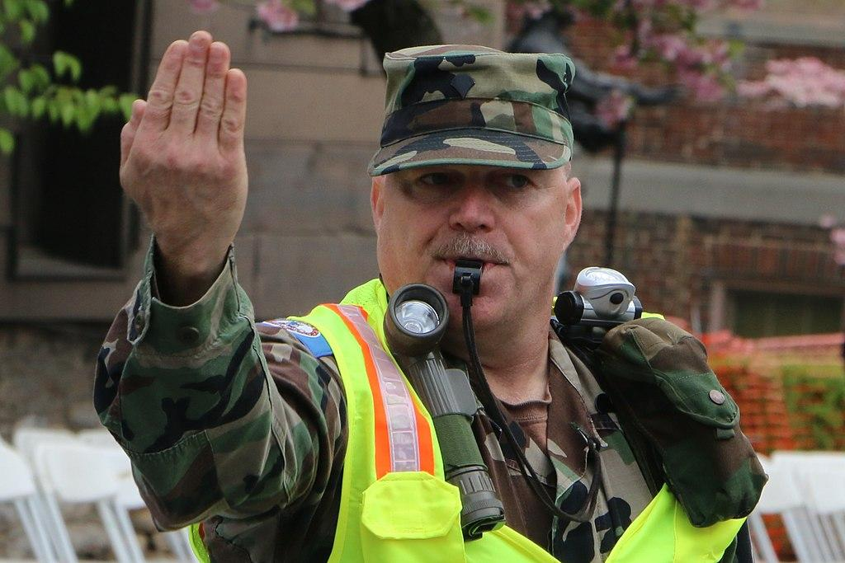
WHY THIS PROJECT?
Using this project we generate a deep learning model which can detect the human gestures. By expanding the scope of this project we can do further work on object detection which can help us to make various real life products related to computer vision like
Traffic control System

Slide 3

We have been motivated by a lot of work that has been done recently on computer vision. We worked on this project to work further on computer vision and object detection.

Slide 4
Cartoon images as training set
Smaller dataset was the challenge
Extract Best Features For Better Detection.
CHALLENGES

Slide 5
COMPUTER VISION
Computer vision is an interdisciplinary scientific field that deals with how computers can be made to gain high-level understanding from digital images or videos.

Slide 6
CONVOLUTIONAL NEURAL NETWORKS (DEEP LEARNING)
In deep learning, a convolutional neural network is a class of deep neural networks, most Commonly applied to analyzing visual imagery.

Slide 7
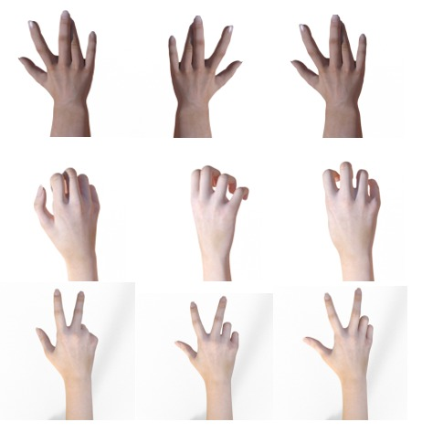
DATASET
Images from the dataset of various hand gestures in varying illumination. And also some augmented dataset is also generated which will generate further images by rotating the images.

Slide 8
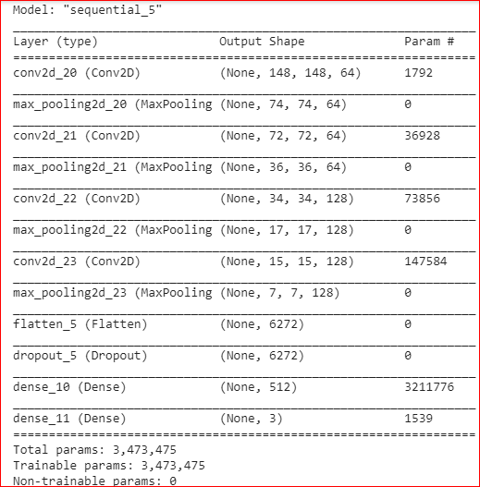
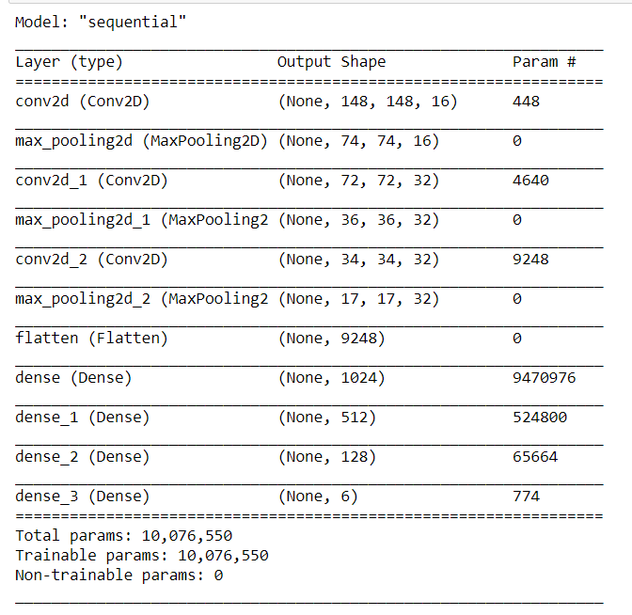
SUMMARY OF MODEL

Slide 9
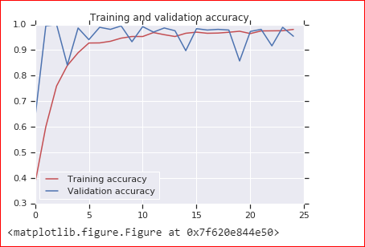
GRAPH OF TRAINING AND VALIDATION ACCURACY AT EACH EPOCH
We have got 95.43% accuracy on test set and 98.10% accuracy on training set after 25 epochs.

Slide 10
OUR PROJECT
Our GUI contains 3 buttons
Load Model
Load model loads the image
Select Image
We can select desired image which we want to predict/classify
Predict
Predict gives us output by Audio/Text format.

Slide 11
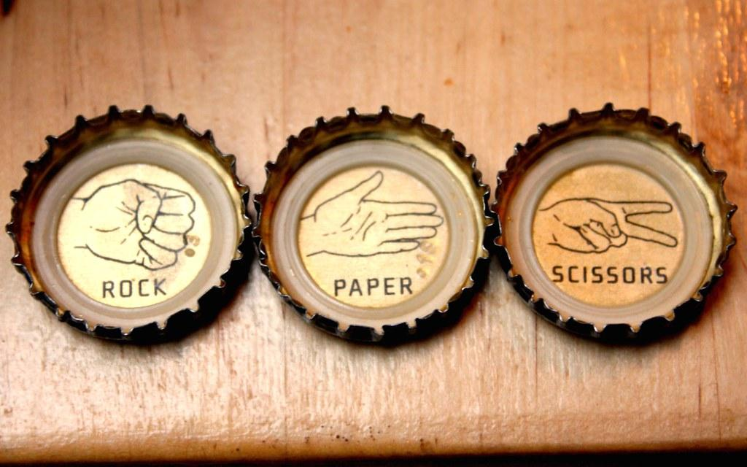
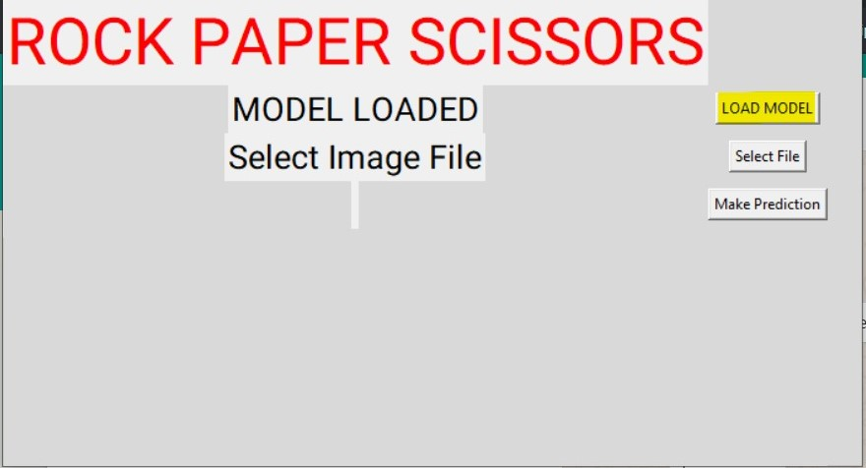

LOAD MODEL

Slide 12
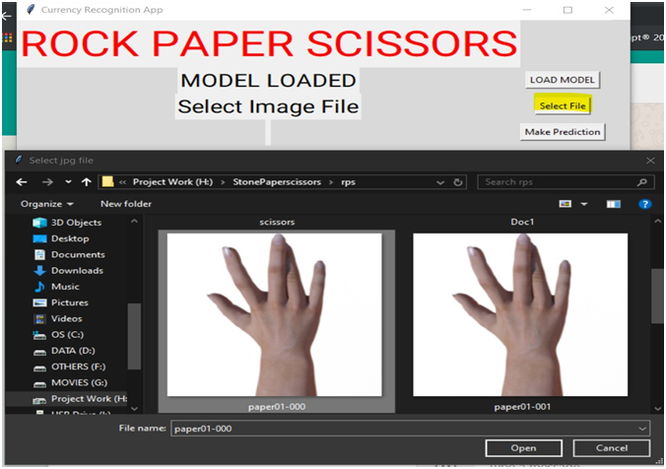
SELECT FILE

Slide 13
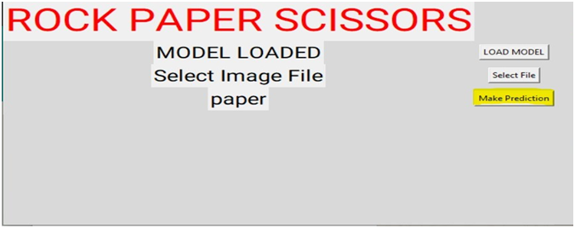

Predict the Image

Slide 15
HOW IT WILL BE USED

